Slide 1
Python programming
unit 1C – pattern matching

Slide 2

New in python 3.10: pattern match
match (value):
Value is evaluated value/object, which will be used to match to case patterns.
case (pattern):
Can have multiple case
Each case has a pattern, each pattern is a way of matching to the value/object from match
From pattern to value, is like “constructing” of value/object.
From value to pattern, thus is somehow like “destructuring”.
Now we learn few simple ways of using match-case.

Slide 3
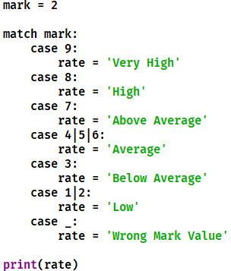
Simple example: literal pattern, wildcard pattern, OR pattern
Literal pattern are literal values of python:
number
string
None
True
False
_ as wildcard for any value. (wildcard pattern)
| as OR pattern, that is either one pattern to match

Slide 4
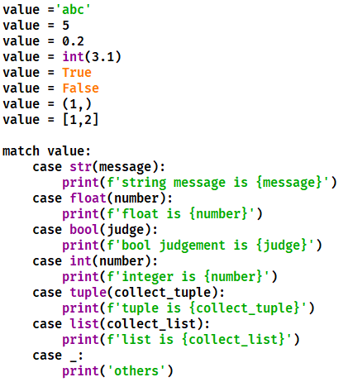
Match to build in class
Can use specific pattern to match to build-in class types
Bool will match to integer type, if integer case is put in front of bool. But integer cannot match to bool. So if have bool and integer at same time, put bool in front of integer.

Slide 5
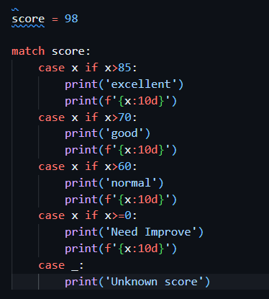
Simple use of guard conditions
use conditions to guard the case.

